Slide 1
Task 14: Final Presentation

Slide 2
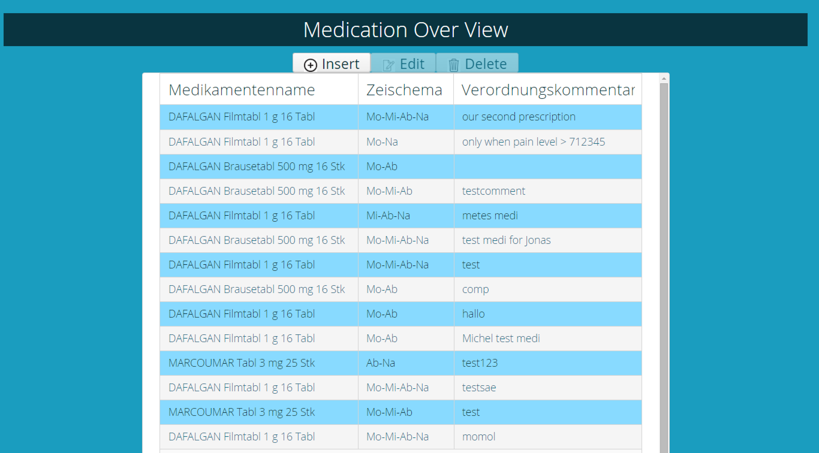
Demo

Slide 3
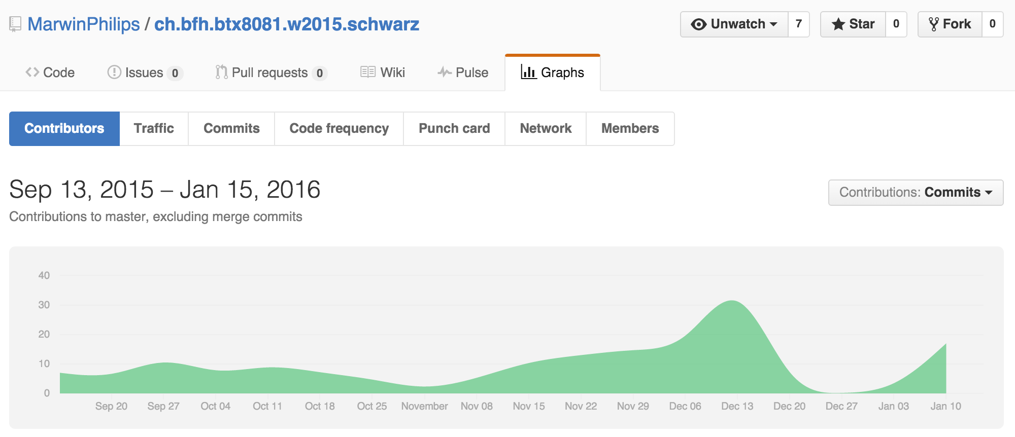
Contributions

Slide 4
<Platzhalter für jedes Teammitglied>

Slide 5
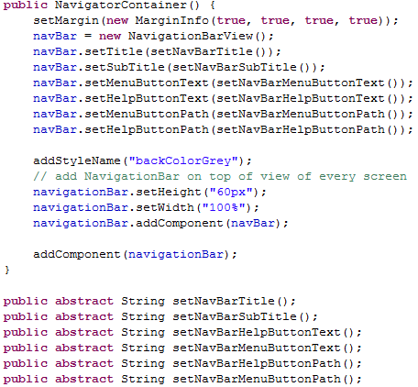
Contribution Jonas Mosimann
NavigationBar functionality
General Bugfixing
Tests for validation

Slide 6

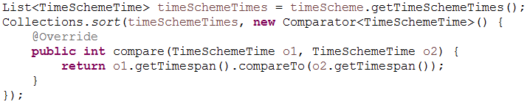
Contribution Marwin Philips
Database connectivity
General support for team members

Slide 7
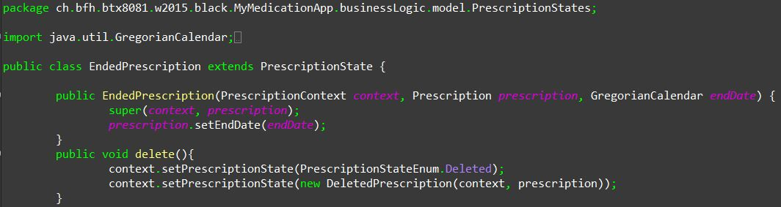
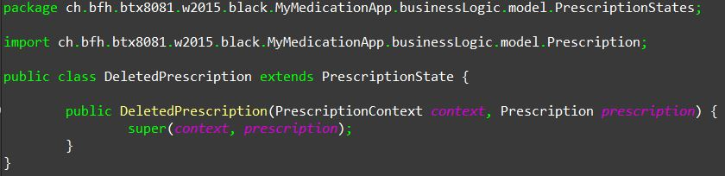
Contribution Michel Murbach
Deleting a new prescription
Aufruf der Methode

Slide 8
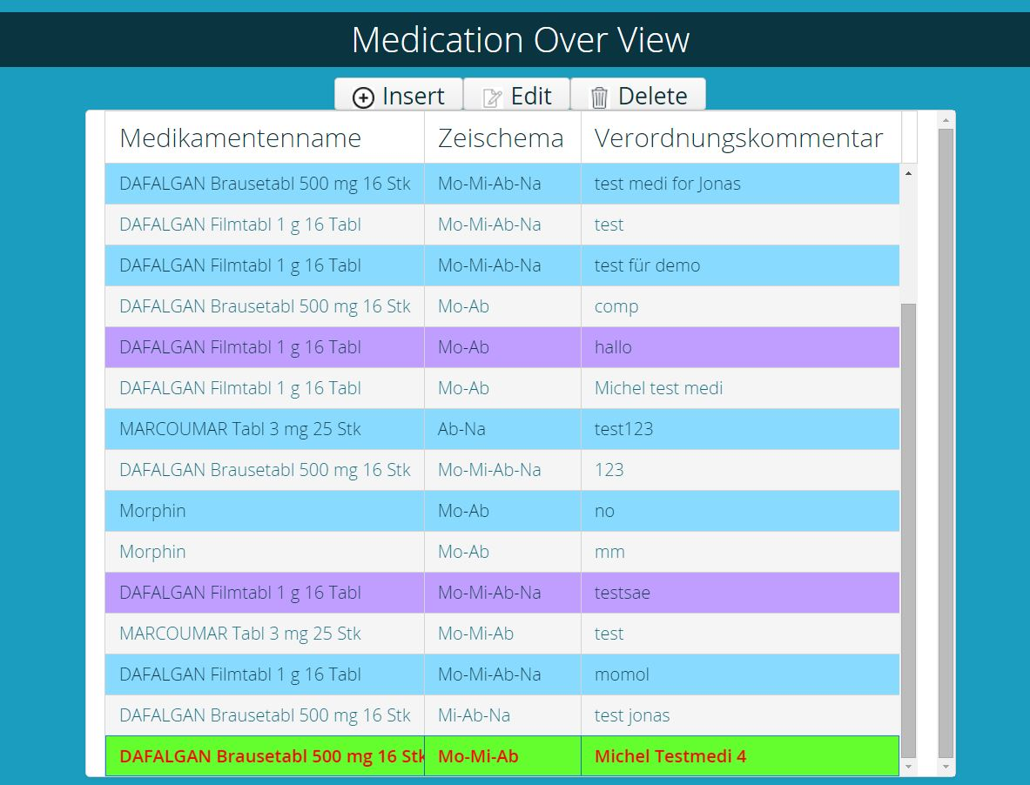
Contribution Michel Murbach
Deleting a new prescription

Slide 9
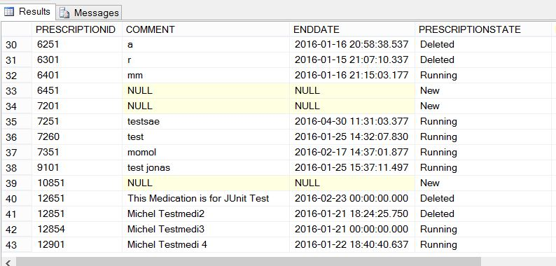
Contribution Michel Murbach
Deleting a new prescription

Slide 10
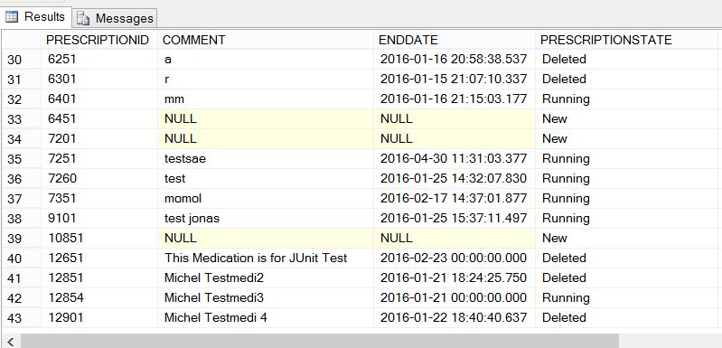
Contribution Michel Murbach
Deleting a new prescription

Slide 11
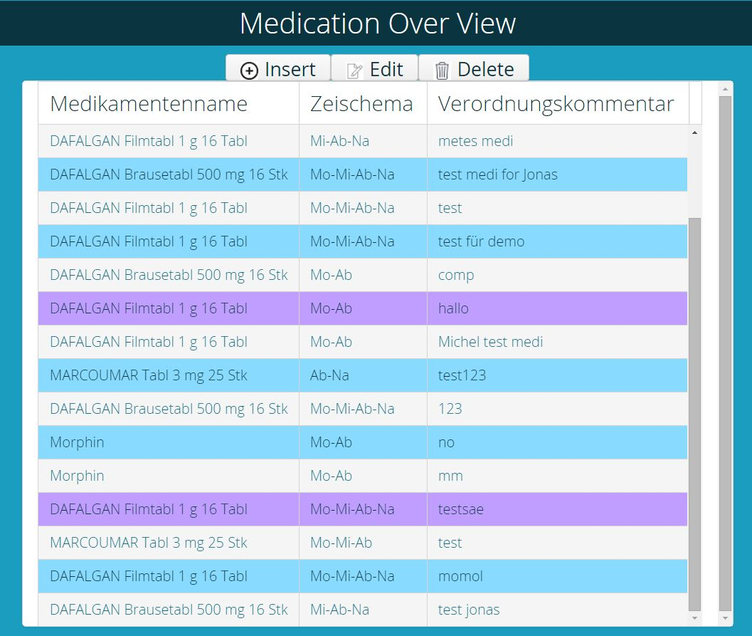
Contribution Michel Murbach
Deleting a new prescription

Slide 12
Contribution Carole Kaiser
Creating Overview of Medication
Styling all Element with mytheme.scss
Support / Pair Programming other Teammembers
Test Classes MsssqlRepository and PerscriptionRepository

